Slide 1
Florida Standards Assessment
Parent Night
PALM VALLEY ACADEMY
March 30th, 2022

Slide 2
Agenda
What are the Florida Standards Assessments?
  Subjects and Grades Assessed
  Test Schedule
  Test Timing
  Test Design and Test Item Types
How are FSA results used?
Helpful Resources

Slide 3
What are the Florida Standards Assessments?
“The F.S.A.”
A test that was designed to serve Florida students by measuring education gains and progress
Measures student performance based on the Florida State Standards
Information from the assessment is used to drive student instruction and course recommendations (Middle School)
This will be the final year of FSA, HOWEVER, we FULLY expect some sort of assessment/s to replace it

Slide 4
Subjects and Grades Assessed
2021-2022 Paper - Based Assessments
    Grade 3 ELA Reading
    Grades 4-6 ELA (Writing (10%) and Reading)
    Grades 3-6 Mathematics
    Grades 5 and 8 Science
2021-2022 Computer - Based Assessments
    Grades 7-8 ELA (Writing and Reading)
    Grades 7-8 Mathematics
Notes:
ADD HIGH SCHOOL EOCs

Slide 5
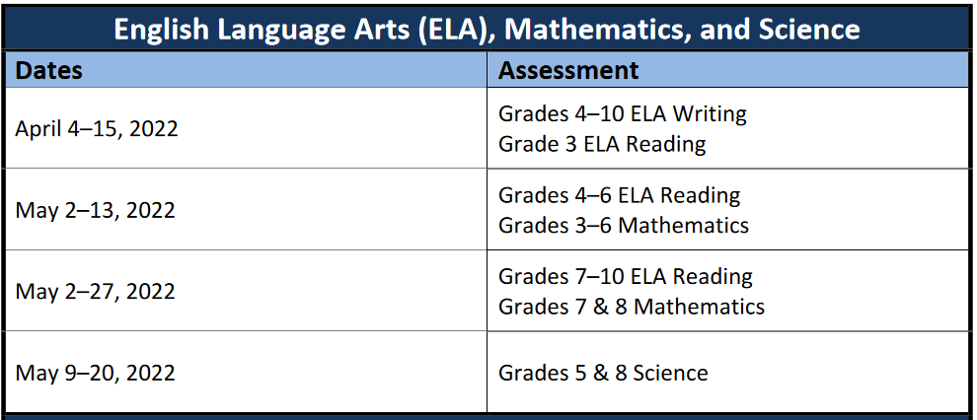
Testing Windows

Slide 6
Paper-Based Test Materials
Grade 3-6 ELA & Mathematics
  Students will receive a Test and Answer Book
  Students will work problems in their test and answer book.
Practice Tests have been developed by DOE. Students will have an opportunity to take the practice test at the school prior to the actual test. Also available on the FSA portal for public access.
  Go to fsassessments.org > Practice Tests
Notes:
UPDATE GRADE LEVEL SPECIFICS

Slide 7
ELA Reading
ELA Reading assessments contain 56-66 items
ELA Reading sessions are administered over two days.
TEST SESSIONS:
-Grade 3-5: Two 80-minute sessions
-Grade 6-8: Two 85-minute sessions
  Each day a short break is given after 40 minutes of testing
Notes:
GRADE LEVEL SPECIFIC TO CHANGE ON OTHER PPTS

Slide 8
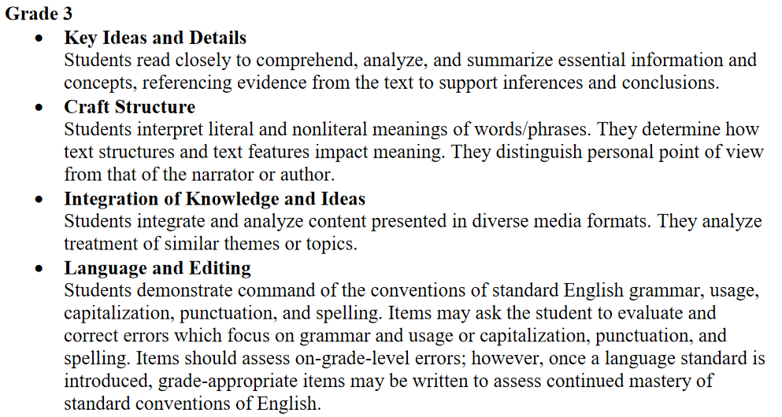
ELA Concepts Tested

Slide 9
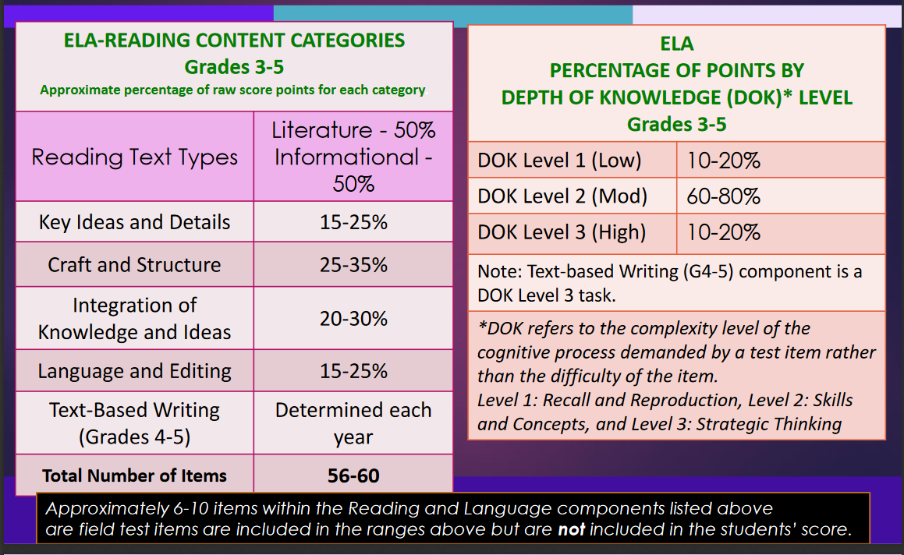
Test Design - ELA
Notes:
GRADE LEVEL SPECIFIC

Slide 10
Test Item Types
ELA Item Types
Multiple Choice
25-50% of test is composed of enhanced items which include...
  Multi-Select
  Selectable Text
  Multi-Part
  Table Match
  Editing Task Choice
Notes:
GRADE LEVEL SPECIFIC

Slide 11
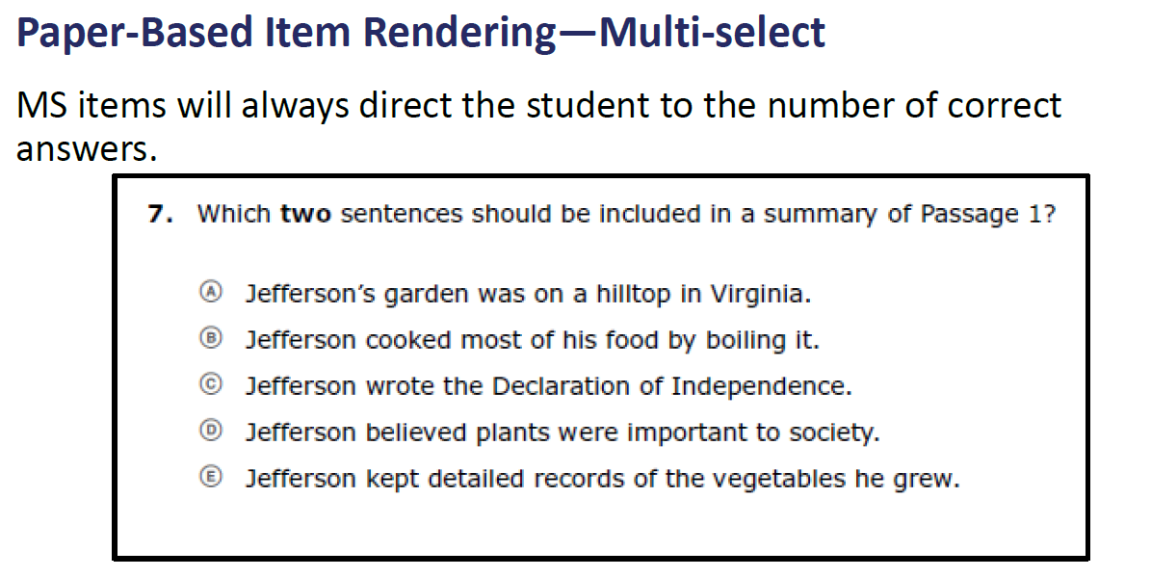
FSA QUESTION TYPES

Slide 12
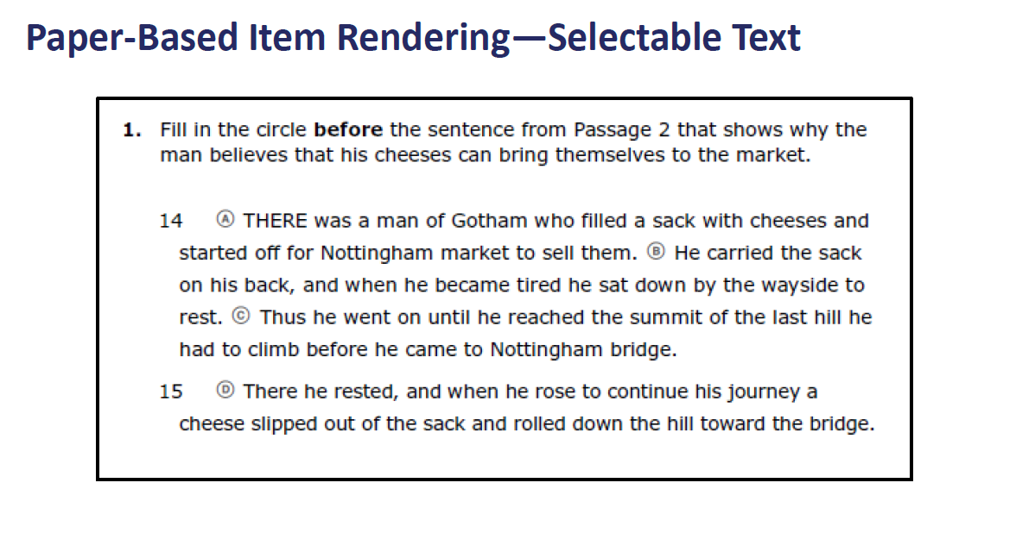
FSA QUESTION TYPES

Slide 13
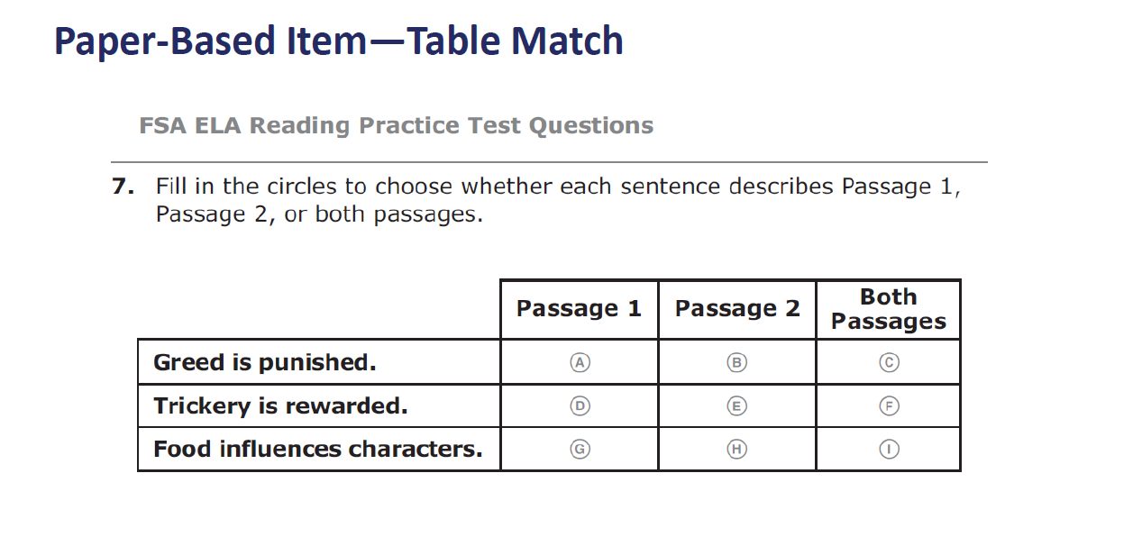
FSA QUESTION TYPES

Slide 14
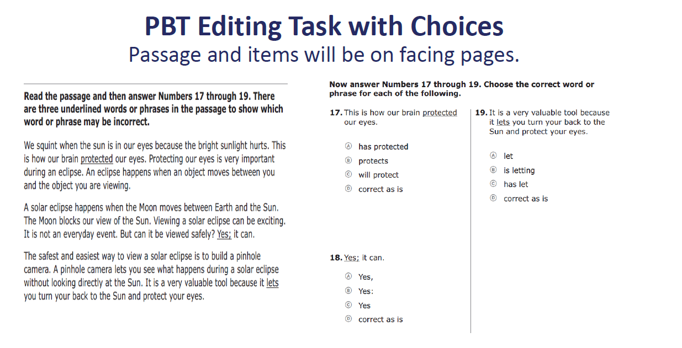
FSA QUESTION TYPES

Slide 15
Mathematics
Math assessments contain 56-66 items
Math sessions are administered over two days.
TEST SESSIONS:
-Grade 3-5: Two 80-minute sessions
-Grade 6-8: Three 60-minute sessions*
*Schools are required to administer Session 1 on day one and Sessions 2 and 3 on day two

Slide 16
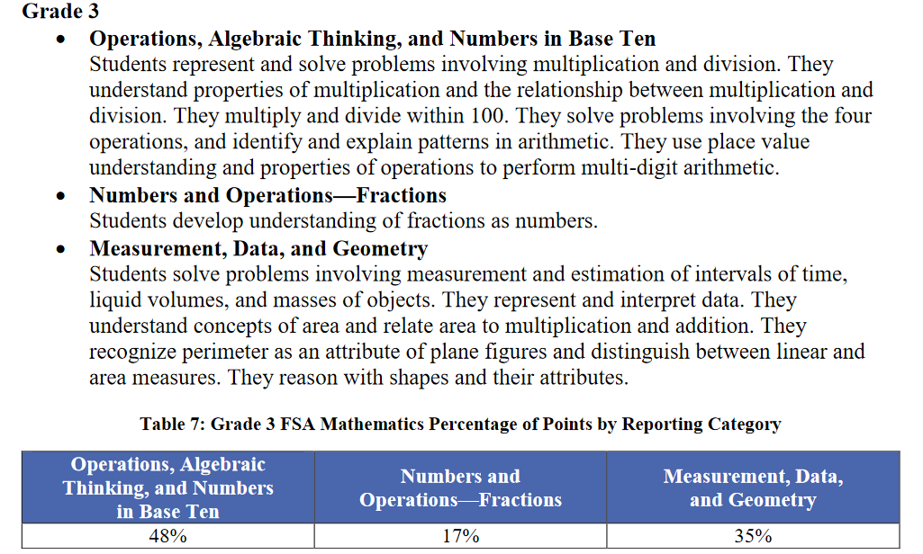
Math Concepts Tested

Slide 17
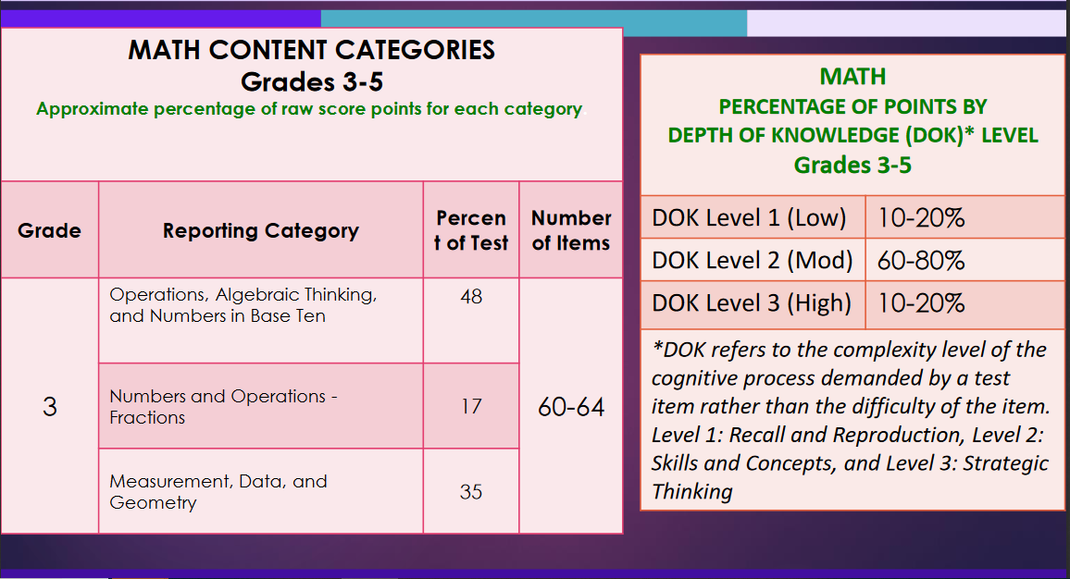
Test Design - MATH

Slide 18
Test Item Types
MATH Item Types
Multiple Choice
Multi-Select
Response Grid
Table Match
Editing Task Choice

Slide 19
FSA QUESTION TYPES
Math
EDITING TASK CHOICE
Students will respond by choosing the correct word or phrase to fill in each blank in a sentence or sentences. For each answer choice box, fill in the bubble before the correct word or phrase. Be sure to respond to each of the editing task boxes in the item.

Slide 20
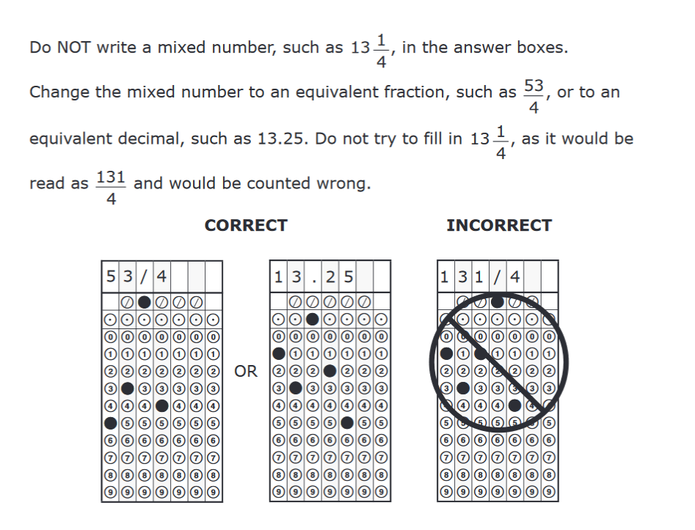
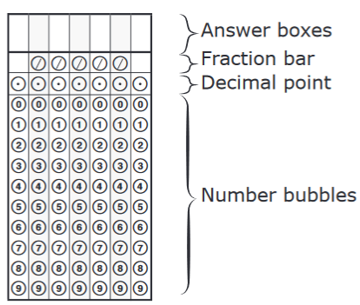
FSA QUESTION TYPES
Math
GRIDDED RESPONSES

Slide 21
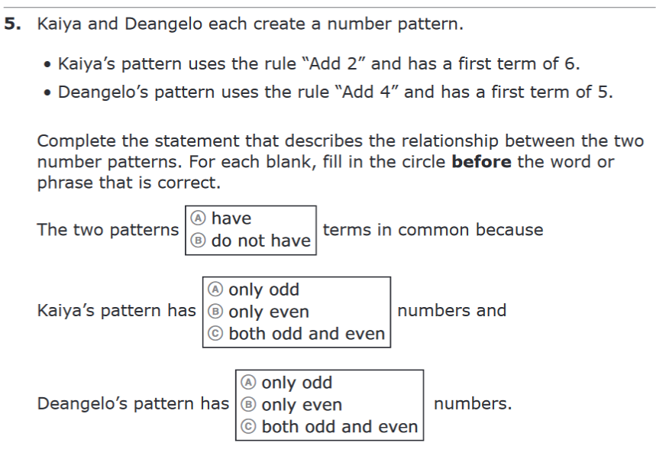
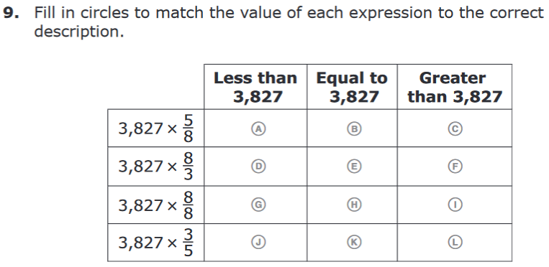
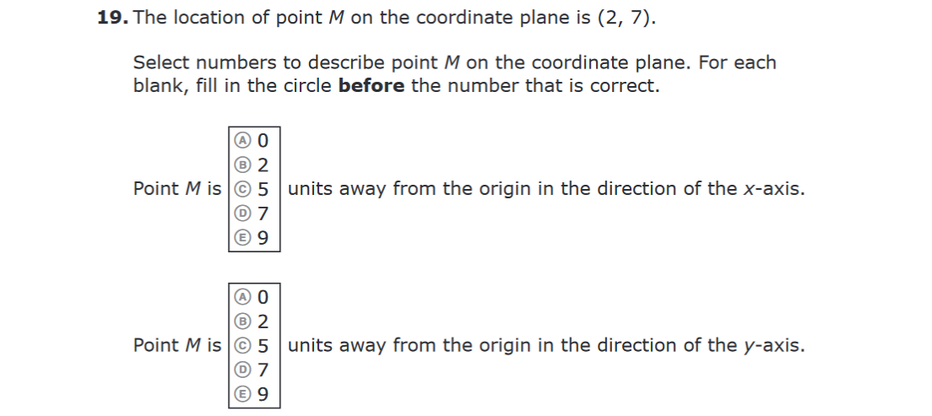

More Math Formats

Slide 22
Grade 3 ELA / Good Cause
  Grade 3 ELA Scores
    Per F.S. 1008.22(5)(b), to be promoted to grade 4, a student must score a Level 2 or higher on the Grade 3 ELA.
    Students who score a Level 1 on ELA may qualify for a good cause exemption for promotion to Grade 4 per Florida State Board Rule 6A-1.094221(1)(A), F.A.C.
  ‘Good Cause’ Exemptions
    I-Ready: 50% or higher (score of 535+ on Diagnostic 3)
      Summer –score of 535+
      August (Diagnostic 1) –score of 535+
    Passing score on the SAT 10 given at the end of Summer Learning Camp
    Student portfolio of 3rd grade mini assessments demonstrating proficiency
    ALL decisions are made on an individual/student basis

Slide 23
Test Design/Scoring
FSA, like other Florida statewide assessments past and present, is not scored using a percent-correct or number-correct scoring method.
Students correctly answering the more-difficult items receive more credit than students answering less-challenging items. In other words, the scoring model involves both the number and the difficulty of questions a student answers correctly.

Slide 24
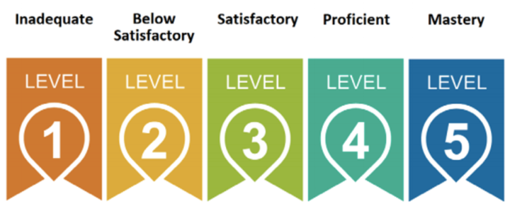
FSA Scores and Performance Indicators
A SINGLE SCORE on an assessment WILL NOT solely determine a student’s placement or “path” the following year
Students will receive a Scaled Score (SS), Achievement Level, Percentile Rank, and Raw Scores
FSA scores are not expected until LATE summer
    Communication will be sent once scores have been released to the school

Slide 25
FSA Score Report
Descriptions of Report:
1 –Identifies student, school, district, test administration
2 –Description of the FSA and resources for teachers, parents, & students.
3 –Performance Levels and Scale Score with information regarding the performance level.
4 –Performance Details lists the reporting categories, number of points possible, and number of points earned for each category.
5 –Performance Comparison shows how your student performed compared to the school, the district, and the state.

Slide 26
How are FSA Results Used?
FSA results are used as an accountability tool for Districts and School Grades
FSA results provide teachers and schools with additional information about each student’s proficiencies.
Results are used IN ADDITION TO teacher observations and coursework throughout the year in making determinations of student strengths and areas of opportunity*
Notes:
Course Recs comments? Middle School?

Slide 27

How do we help your student prepare?
  Challenging & Viable Curriculum aligned to tested standards, delivered by highly qualified educators
  Use of research-based textbooks
  PLC’s
  Common assessments and practice tests to set format and content expectations
  Frequent progress monitoring and data disaggregation
  Interventions supporting students who have learning gaps
  Small group, differentiated instruction
  Support Facilitation

Slide 28
How can you help your student prepare?
  Help your child realize this is not a test you can study for. However, it is very important they do their best every day leading up to and on the FSA Days
  Ensure that your child participates in the practice tests so that he/she becomes familiar with the items
  Help your child get a good night sleep and eat a nutritious breakfast
  Provide Emotional and Positive Support
    Talk to your child and encourage them
    Work with your child to help them learn how to lower anxiety/stress about the test
  Arrive to school every day – attendance is crucial

Slide 29

Helpful Resources
FSA Portal
www.FSAssessments.org
Florida State Standards (cpalms)
http://www.cpalms.org/Public
Florida Department of Education Web Site
http://www.fldoe.org
School Accountability Reports
http://schoolgrades.fldoe.org

Slide 30
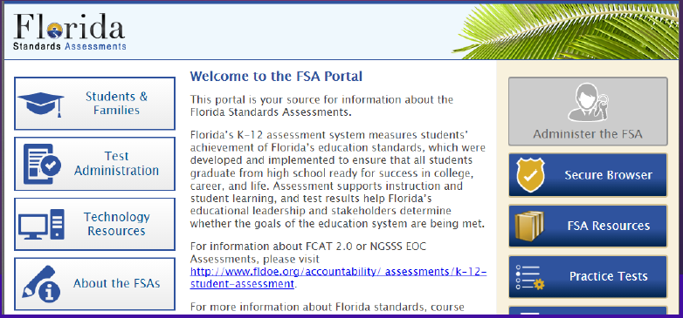
FSA Portal
FSA Portal: www.FSAssessments.org
  The FSA Portal was developed as a communication tool by the Florida Department of Education and contains all published information regarding FSA assessments, and released Practice Tests
  Access to the portal and information is public.

Slide 31
PVA Contacts
Dr. Joy Reichenberg, Principal: Joy.Reichenberg@stjohns.k12.fl.us
Mr. Brian Green, AP (K-2): Brian.Green@stjohns.k12.fl.us
Ms. D’Niessa Slocum, AP (6-8): Dniessa.Slocum@stjohns.k12.fl.us
Mr. Zach Strom, AP (3-5): Zachary.Strom@stjohns.k12.fl.us
Ms. Audra Wilson, Testing Coordinator: Audra.Wilson@stjohns.k12.fl.us
Ms. Amie Miller, Literacy Coach: Amie.Miller@stjohns.k12.fl.us

Slide 32
Questions and Answers

