Slide 1
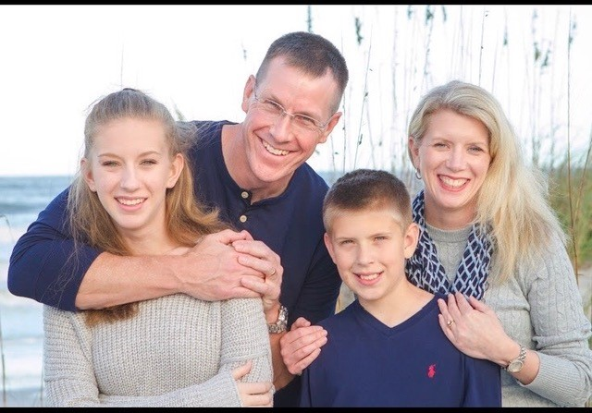
Mrs. Anderson
Welcome to 2nd Grade! I am so happy to be teaching 2nd grade at PVA again this year! I am a UF graduate, and an avid Gator fan. I’ve been married for 25 years, and I have 2 children of my own, a 19-year-old daughter and a 15-year-old son. Teaching is a passion, and I am blessed to call it my job as well.
Today is a good day for a good day!
Favorites:
Books: Heidi, Anne of Green Gables, Nancy Drew
Hobbies: Hiking in the mountains, spending time with family
Food: Chocolate!

