Slide 1
Palm valley Academy Middle School Course Information 2025-2026 school year
Welcome to Middle School!
PART 1

Slide 2
Your PVA Middle School Support Team
Role | Name
Principal | Mr. Zach Strom
Assistant Principal | Ms. Ashley Zapata
Assistant Principal | Ms. Amy Nass
Assistant Principal | Ms. Bonnie Curran
Counselor | Ms. Corinne Fennelly
Dean | Mr. James Puckett
Instructional Literacy Coach | Ms. Amie Miller

Slide 3
6th Grade Course Requirements
Core Subjects (Standard or Advanced) | Non-Core Subjects
Language Arts | Digital Discoveries 6th (ICT)
Math
Science | Physical Education
World History

Slide 4
7th Grade Course Requirements
Core Subjects (Standard or Advanced) | Non-Core Subjects
Language Arts | Physical Education
Math
Science
U.S. History

Slide 5
8th Grade Course Requirements
Core Subjects (Standard or Advanced) | Non-Core Subjects
Language Arts | Physical Education
Math
Science
Civics

Slide 6
What are the right placement options for my child?
PVA offers class levels for middle grade students depending on their individualized learning path:
Standard, Advanced, and for some subjects, High School Honors
Standard and advanced classes teach the same standards. Advanced sections may go in more depth, higher level analyzing/critical thinking, and may move through some content faster.
Taking standard courses in middle school does not mean that your child won’t qualify for accelerated high school classes.

Slide 7
Middle School Course sequences

Slide 8
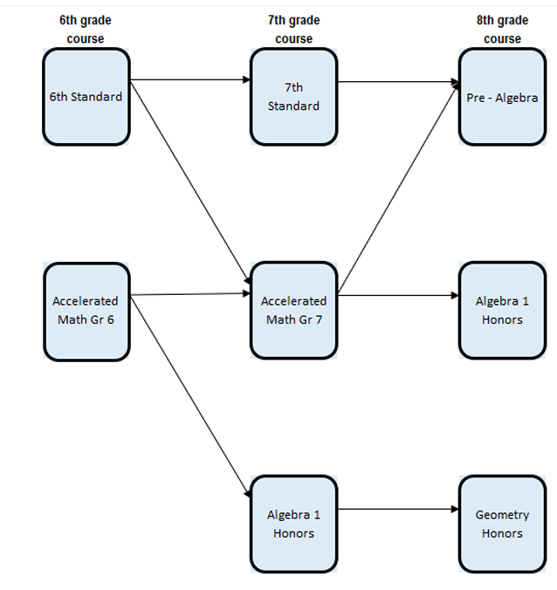
Middle School Math Progression

Slide 9
Course Recommendations
Academic course placements for 2025-2026 will be available in HAC 3/3. (Log in as your child to view)
Placements are based on teacher recommendations, assessments, FSA/FAST scores, and classroom performance.
Placement change requests will be considered but not guaranteed.
All CORE change requests must be done through the PVA COURSE REVIEW FORM (website)
Final FAST scores may impact Advanced class eligibility—consider reaching out after they are scored.

Slide 10
Middle School Electives
Enrollment in electives are not guaranteed (MUST RANK 1-3)
All students are required to take the following:
Physical Education
One elective of choice for 6th Grade
Two electives of choice for 7th and 8th Grade
Exceptions may be made on a per student basis

Slide 11
Elective Options: PVA
Students may choose from the following electives for the 2025-2026 year:
6th | 7th | 8th
Studio Art | Studio Art | Studio Art
Exploratory Spanish | Beginning Spanish | Intermediate Spanish
 | STEM/Digital Discoveries (7) | STEM/Digital Discoveries (8)
News Crew/TV Pro* | News Crew/TV PRO* | News Crew/TV Pro*
 | Creative Writing | Creative Writing
Band 1 | Band 1, 2, and/or Jazz Band | Band 1, 2, 3 and/or Jazz Band
 | Guitar | Guitar
Theatre | Theatre | Theatre
Middle School 101
 | Yearbook* | Yearbook*
 |  | W.E.B.*
*Indicates a separate application is required.
All courses will be tentatively offered based on demand and PVA staffing.
If a student is required to take Intensive Reading, the second and/or third elective (non-core) course may be replaced with these necessary intervention courses.

Slide 12
Directions for Elective Request
Students will be given a paper in their homeroom/1st period class with a list of electives (2/20)
Of those listed, students will rank their TOP THREE electives in order of preference
Forms must be submitted to 1st period teacher by FRIDAY Feb 28
*Please note, students may not necessarily get their first choice, but we will work to the best of our ability to ensure they get one of their TOP THREE choices

Slide 13
Contact Information:
Ashley Zapata, Assistant Principal: Ashley.Zapata@stjohns.k12.fl.us
Corinne Fennelly, Middle School Counselor corinne.fennelly@stjohns.k12.fl.us
For help accessing HAC, please reach out to:
Tatiana Tomei Marques, Computer Operator: tatiana.tomeimarques@stjohns.k12.fl.us

Slide 14
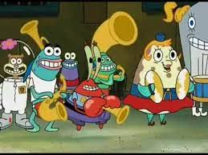
Join Band!!!
Mr. Mattheus

Slide 15
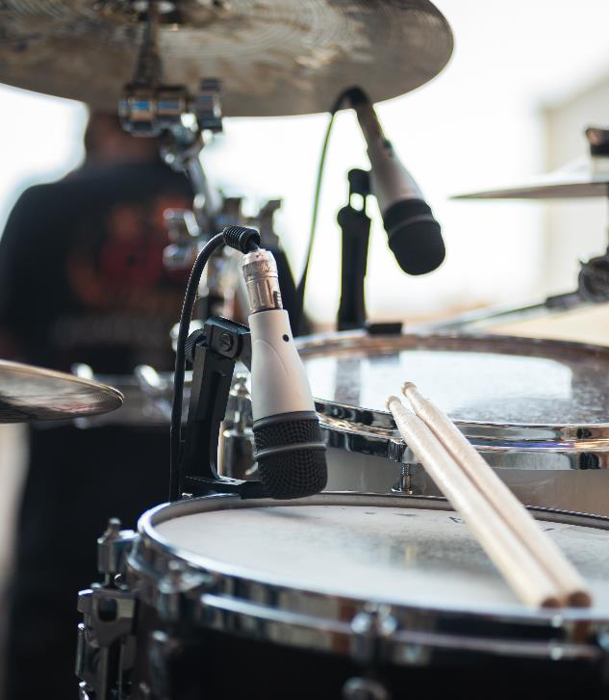
Benefits to playing a musical instrument
Increases Memory Skill and Iq (full body workout for the brain)
Teaches perseverance and ability to achieve
Improves Reading comprehension and math skills
Creates Responsibility
Instills a higher appreciation for Music.
If you want to be in band, you will be in band!
It’s fun!

Slide 16
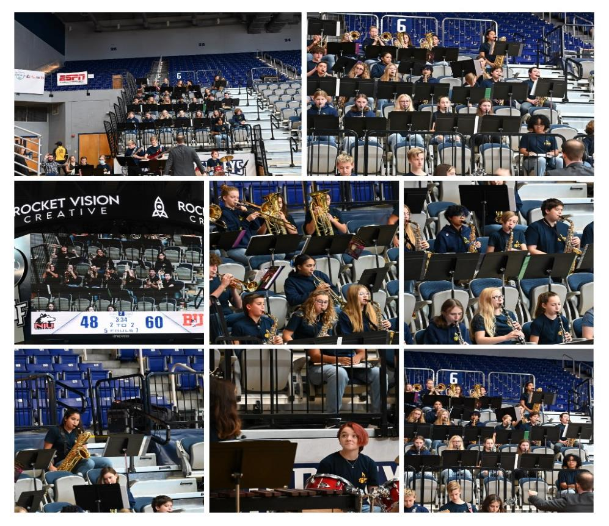
Field Trip Opportunities
Marching band night (play with high school students)
Night of Lights!!!!
MPA

Slide 17
Instruments offered:
Brass: Trumpet, Trombone, Euphonium, Tuba.
Woodwinds: Clarinet, Flute, Alto Saxophone
Percussion (bells, snare drum etc.)

Slide 18
Frequently asked questions
Does my student have to know how to play an instrument? (no)
How will my student pick an instrument? (tryout process)
Where to get our instrument? (Rhapsody music usually in September)
How often should they practice? (4 days a week 15 min)
Piano? (not in band, but through audition in Jazz Band)

Slide 19
Questions? Please email!
Jordan.Mattheus@stjohns.k12.fl.us
CLICK HERE for PART 2

