Slide 1
Rising 6th grade parents
Welcome to Middle School!
PART 2
Additional info ahead…

Slide 2
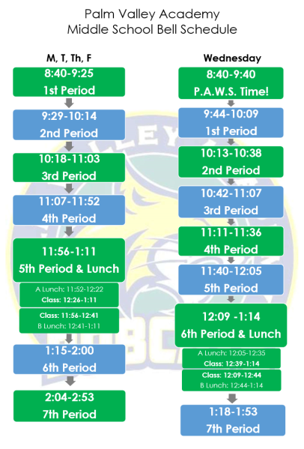
7 Period Day
45 min classes
4 min transitions (varies)
2 Lunch periods
Lunch may switch on Wednesdays
*Kids will sit with classmates during the first weeks to ensure everyone meets someone and feels comfortable in the lunchroom

Slide 3
Grading in middle school
Category | Formative | Summative
Weighting | 30% | 70%
What are remediations and re-takes?

Slide 4
What is Hac?
Home Access center connects you to teachers, their gradebooks, your child’s schedule, is used to select classes, and more!
Report cards
All students are given access (homeroom teachers can assist them with their login id and password.)
To set up a new Parent/Guardian HAC account click here
Contact tatiana.tomeimarques@stjohns.k12.fl.us if you still need assistance.
HAC FAQ

Slide 5
What is Schoology?
Schoology is an online tool that manages curriculum, assessments, grading and other classroom management tasks and is also a communication platform for educators and students in grades K -12.
This tool will be an integral part of how teachers design and implement their lesson plans, assignments and grades. They will use it to post updates to their class and communicate with parents. Parents will be able to see what their children are working on.
https://www.stjohns.k12.fl.us/media/schoology/schoology-for-families/

Slide 6
What else to expect in ms…
Concerns | Solutions
Lots of teachers’ systems to learn | Check Schoology with your child at least weekly
More work/due dates | Teach your child to use their planner
Heavy backpack | Locker- practice a combination dial lock with your child.
Less communication from teachers | Use Schoology to message teachers your concerns

Slide 7
MS BACK TO SCHOOL BASH!
6th Grade students only
Learn all things middle school
Run by 8th grade web kids and peers
Be on the lookout for dates and further info
THIS SUMMER!

Slide 8
PVA Athletics VS. SJMSA
School Sponsored Athletics
SJMSA Sponsored Events
Basketball
Volleyball
Football
Cheerleading
Flag football
Soccer
Baseball
Softball
Golf
Tennis
Dance team
Please visit the SJMSA website for more information

